Slide 1
Computer Architecture
CSC-250
COURSE LECTURE
COMPUTER SCIENCE DEPARTMENT
SIBAU KANDHKOT CAMPUS

Slide 2
Computer Architecture
A very good example of computer architecture is von Neumann architecture, which is still used by most types of computers today.
This was proposed by the mathematician John von Neumann in 1945. It describes the design of an electronic computer with its CPU, which includes the arithmetic logic unit, control unit, registers, memory for data and instructions, an input/output interface and external storage functions
Involves Logics (instruction address data types memory optimization)
Show responsibility who does interconnect & connectivity structure
Functional requirements
High level design
Focus on understanding problem

Slide 3
Computer Architecture
A modern computer is an electronic, digital, general purpose computing machine that automatically follows a step-by-step list of instructions to solve a problem. This step-by step list of instructions that a computer follows is also called an algorithm or a computer program.
Why study computer organization and architecture?
  Design better programs, including system software such as compilers, operating systems, and device drivers.
  Optimize program behavior.
  Evaluate (benchmark) computer system performance.
  Understand time, space, and price tradeoffs.
Computer organization
  Encompasses all physical aspects of computer systems.
  E.g., circuit design, control signals, memory types.
  How does a computer work?

Slide 4
Computer Architecture
Visible attributes of system to programmer
System competitive techniques for addressing design
Structural behavior
Instruction Set Architecture (ISA): This is the embedded programming language of the central processing unit.
It defines the CPU's functions and capabilities based on what programming it can perform or process.
This includes the word size, processor register types, memory addressing modes, data formats and the instruction set that programmers use.
Microarchitecture: Otherwise known as computer organization, this type of architecture defines the data paths, data processing and storage elements, as well as how they should be implemented in the ISA.

Slide 5
Computer Architecture
Focuses on the structure (the way in which the components are interrelated) and behavior of the computer system and refers to the logical aspects of system implementation as seen by the programmer
Computer architecture includes many elements such as
  instruction sets and formats, operation codes, data types, the number and types of registers, addressing modes, main memory access methods, and various I/O mechanisms.
The architecture of a system directly affects the logical execution of programs.
The computer architecture for a given machine is the combination of its hardware components plus its instruction set architecture (ISA).
The ISA is the interface between all the software that runs on the machine and the hard
Studying computer architecture helps us to answer the question: How do I design a computer?

Slide 6
Computer Architecture Layer
The term layer with regard to computer architecture typically represents the way abstraction is used to describe computer systems.
A layer is the term used to describe the different levels at which you can place an object.
There are many different abstractions that have been used in computer architecture.
If you restricted yourself to four layers, they may be defined as:
1) algorithm,
2) programming language/compiler,
3) processor/memory,
4) I/O.

Slide 7
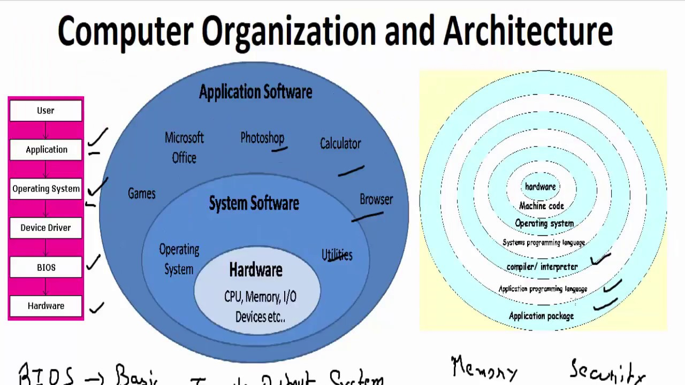

Slide 8
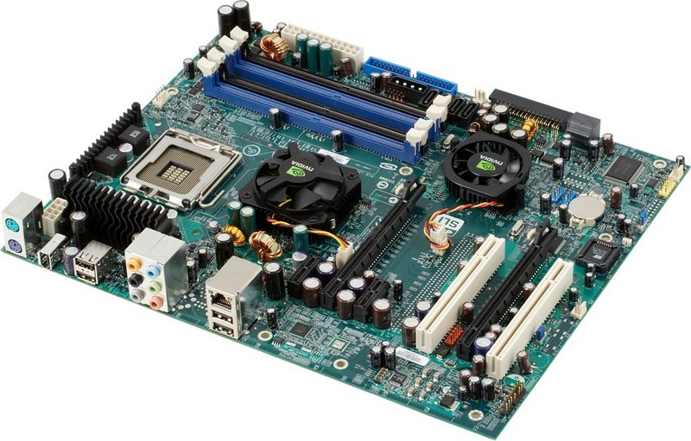

Slide 9
Design
This includes all hardware components in the system, including data processors aside from the CPU, such as the graphics processing unit and direct memory access.
It also includes memory controllers, data paths and miscellaneous things like multiprocessing and virtualization.
Develop system components
Understand configuration
Hardware design

Slide 10
Why We Study Computer Architecture
The study of computer architecture and organization focuses on the interface between hardware and software, and emphasizes the structure and behavior of the system.
As computer users, we probably do not have to worry about this anymore than we need to know what our cars look like under the hood in order to drive them.
We can certainly write high label language programs without understanding how these programs execute.
We can use various application packages without understanding how they really work. But what happens when the program we have written needs to be faster and more efficient or the application we are using does not do precisely what we want?
As Computer Scientists, we need a basic understanding of computer system itself in order to rectify these problems.

Slide 11
Computer Architecture & Organization
Architecture is those attributes visible to the programmer
  Instruction set, number of bits used for data representation, I/O mechanisms, addressing techniques.
  e.g. Is there a multiply instruction?
Organization is how features are implemented
  Control signals, interfaces, memory technology.
  Organization differs between different versions
  e.g. Is there a hardware multiply unit or is it done by repeated addition?

Slide 12
Structure
A hierarchical set of interrelated sub system
At each level system is consist of a set of components
The way in which the components are interrelated
Internal structure of a digital computer, encompassing the design and layout of its instruction set and storage registers.
Top to Bottom
Bottom to Top

Slide 13
Computer Organization Vs Architecture
Computer organization refers to the operational units and their interconnections that realize the architectural specifications.
Computer architecture refers to those attributes of a system visible to a programmer or, put another way, those attributes that have a direct impact on the logical execution of a program.

Slide 14
Computer Organization includes………
Realization of a hardware
Organization is how features are implemented
    Hardware details – Such as RAM, Hard drive , graphic card technology used.
    Peripherals Devices – How devices such as mouse and keyboard, connected to the computer.
    Control signals. Generating from above mentioned controls

Slide 15
Computer architecture includes……..
Instruction set, number of bits used for data representation, I/O mechanisms, addressing techniques.
  Physical memory – Allocated and Available
  ISA (Instruction Set Architecture) of the processor.
  The number of bits used to represent data types like integer , character , double etc.
  Input Output mechanism – Depends on programming language.
  Technique for addressing memories – Depends on programming language

Slide 16
Concept of computer ‘Family’
A computer family is a category of computers with similar designs and microprocessors that are compatible.
Good examples of different computer families are the IBM or PC family versus the Apple or Mac family of computers
Mostly, all computer families have successive generations, they do share the same architecture. But there are always exceptions

Slide 17
Structure Vs Function
Computer is a complex system with millions of elementary electronic components. How can one describe them?
  Key is to recognize the hierarchical nature of the system
At each level of hierarchy designer is concerned with two things:
  Structure: the way in which components relate to each other
  Function: the operation of individual components as part of the structure

Slide 18
Functions of Computer
Data processing
    Sorting
    Arithmetic
Data movement
    Moving data to directly connected device, known as I/O
    Moving data to remote device, known as Data Communication
Data storage
    Must be able to store data
    Even if data is processed on fly
    Short term storage, Long term storage
Control
    Programmers control these functions by providing instructions
    Control unit manages the resources in response to those instructions

Slide 19
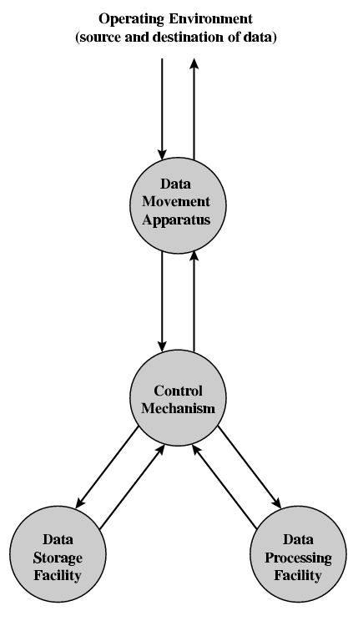
Functional View

Slide 20
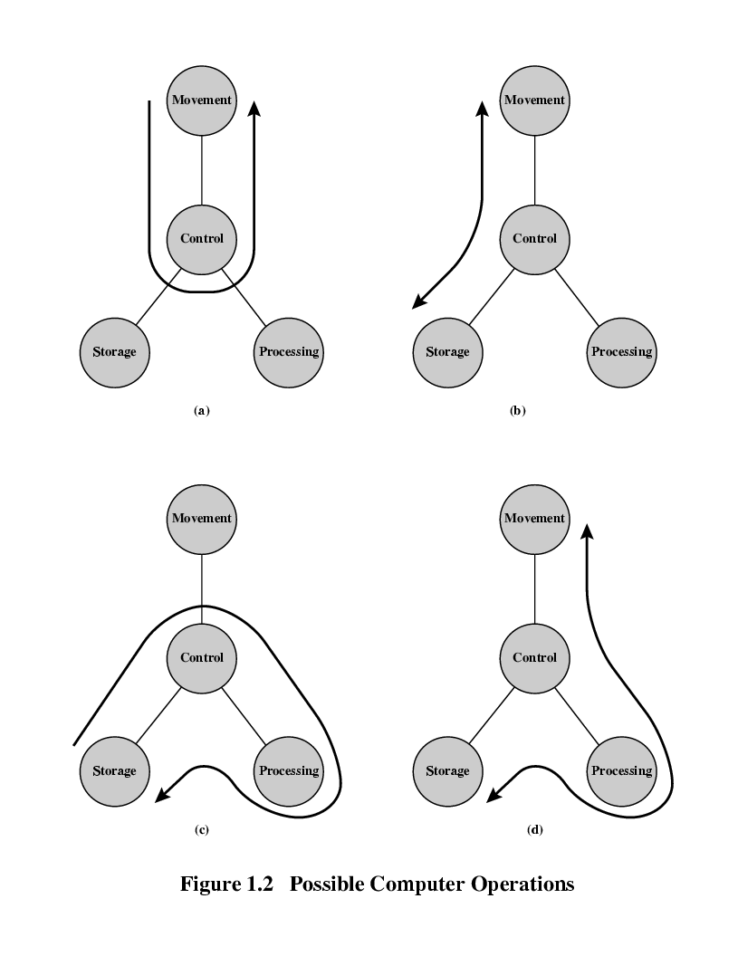
Data movement

Slide 21
Storage

Slide 22
Processing
(From or To Storage)

Slide 23
Processing
(From or To I/O)

Slide 24
Structure - Top Level
(Four main structural Components)
There may be one or more of each of these components
Computer
Peripherals
Central
Processing
Unit
Main
Memory
Computer
Systems
Interconnection
Input
Output
Communication
lines

Slide 25
Structure - The CPU
CPU
Computer
Arithmetic
and
Login Unit
I/O
Registers
System
Bus
CPU
Internal CPU
Interconnection
Memory
Control
Unit

Slide 26
Structure - The Control Unit
Control Unit
CPU
Sequencing
Logic
circuit
ALU
Internal
Bus
Control
Unit
Control Unit
Registers and
Decoders
Registers
Control
Memory

Slide 27
The Control Unit
A sequence logic circuit type of logic circuit whose output depends not only on the present value of its input signals but on the sequence of past inputs, the input history as well.
A Control Memory is the storage in the microprogrammed control unit to store the microprogram. Writeable Control Memory: Control Storage whose contents can be modified, allow the change in microprogram and Instruction set can be changed or modified is referred as Writeable Control Memory.
A Control Unit typically uses Registers and Decoders to hold and convert coded instructions into timing and control signals that direct the operation of the other units (memory, arithmetic logic unit and input and output devices, etc.).

Slide 28
Assignment – 1
Is hard disk a peripheral device?
Why or why not?
Is there a hardware multiply unit or is it done by repeated addition?
Explain by writing a sample program?

Slide 29
Parts of Computer Hardware
Input
Devices
STORAGE DEVICES
(Hard Disk, CD Drive, DVD Drive, Floppy Drive etc.)
BUS
Microprocessor
Extended Slots
Power
Supply
BUS
Ports
Output
Devices
BUS
BUS
BUS
Memory Unit (RAM, ROM, Cache)

Slide 30
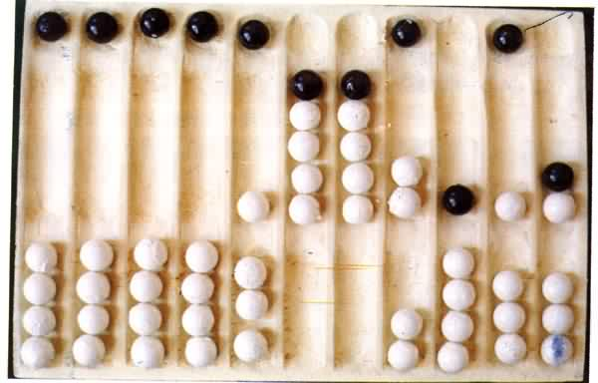
Year : 300 B.C
ABACUS

Slide 31
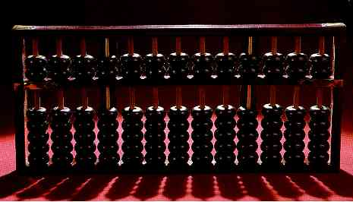
Modern Abacus
Note how the abacus is really just a representation of the human fingers: the 5 lower rings on each rod represent the 5 fingers and the 2 upper rings represent the 2 hands.

Slide 32
Year : 1617 A.D
Logarithms:
John Napier invented logarithms, which
are a technology that allows multiplication
to be performed via addition.

Slide 33
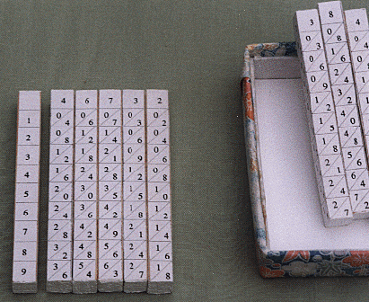
Napier’s Bones
The logarithm of each operand was originally obtained from a printed table, but Napier bones were alternative to tables, where the logarithm values were carved on ivory sticks .

Slide 34
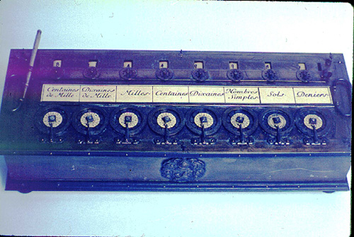
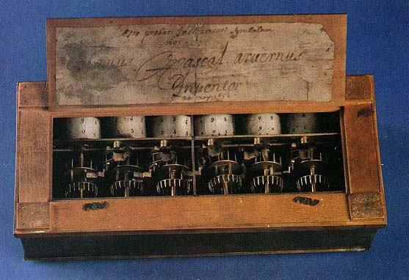
Year : 1642 A.D
Blaise Pascal, at age 19, invented the Pascaline as an aid for his father who was a tax collector.
Up until the present age when car dashboards went digital, the odometer portion of a car's speedometer used the very same mechanism as the Pascaline to increment the next wheel after each full revolution of the prior wheel.

Slide 35

Just a few years after Pascal, the German Gottfried Wilhelm
Leibniz (co-inventor with Newton of calculus) managed to build a
four-function (addition, subtraction, multiplication, and division)
calculator that he called the stepped reckoner because, instead
of gears, it employed fluted drums having ten flutes arranged
around their circumference in a stair-step fashion.
Although the stepped reckoner employed the decimal number
system (each drum had 10 flutes), Leibniz was the first to
advocate use of the binary number system which is fundamental
to the operation of modern computers. Leibniz is considered one
of the greatest of the philosophers but he died poor and alone.

Slide 36
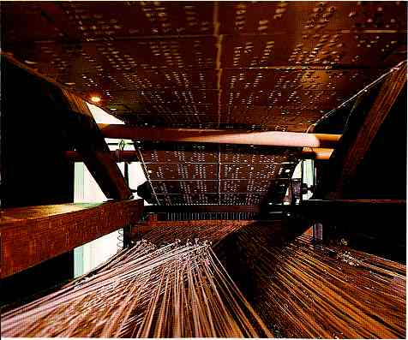
Year: 1801 A.D (Punch Cards)
The Frenchman Joseph Marie
Jacquard invented a power
loom that could base its weave
(and hence the design on the
fabric) upon a pattern
automatically read from
punched wooden cards, held
together in a long row by rope.

Slide 37
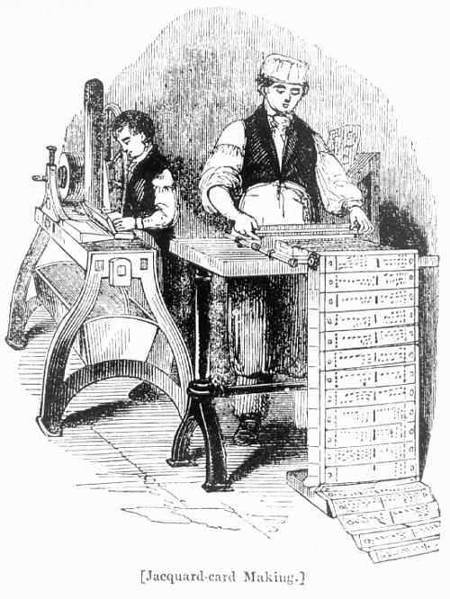
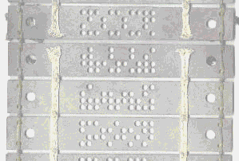
Punch card or Jacquard card
A closer look

Slide 38
Year : 1822 A.D
The English mathematician Charles Babbage was proposing a steam driven calculating machine the size of a room, which he called the Difference Engine. This machine would be able to compute tables of numbers, such as logarithm tables.

Slide 39
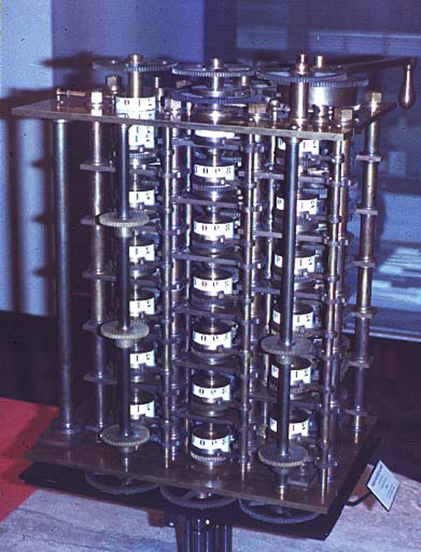
The Difference Engine
A small section of the type of mechanism employed in Babbage's Difference Engine [photo © 2002 IEEE]

Slide 40
Analytical Engine
This device, large as a house and powered by 6 steam engines, would be more general purpose in nature because it would be programmable, thanks to the punched card technology of Jacquard.
In the Jacquard loom, the presence or absence of each hole in the card physically allows a colored thread to pass or stops that thread (you can see this clearly in the earlier photo). Babbage saw that the pattern of holes could be used to represent an abstract idea such as a problem statement or the raw data required for that problem's solution. Babbage saw that there was no requirement that the problem matter itself physically pass thru the holes.

Slide 41
Analytical engine (ctd...)
Furthermore, Babbage realized that punched paper could be employed as a storage mechanism, holding computed numbers for future reference. Because of the connection to the Jacquard loom, Babbage called the two main parts of his Analytic Engine the "Store" and the "Mill", as both terms are used in the weaving industry. The Store was where numbers were held and the Mill was where they were "woven" into new results. In a modern computer these same parts are called the memory unit and the central processing unit (CPU).

Slide 42
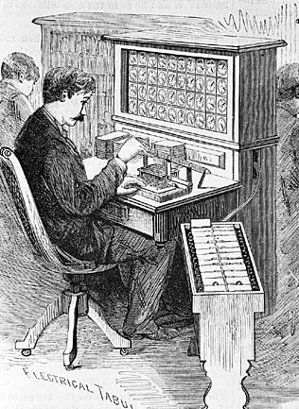
Year : 1890 A.D
Herman Hollerith's invention, known as the Hollerith desk, consisted of a card reader which sensed the holes in the cards, a gear driven mechanism which could count (using Pascal's mechanism which we still see in car odometers), and a large wall of dial indicators (a car speedometer is a dial indicator) to display the results of the count.

Slide 43
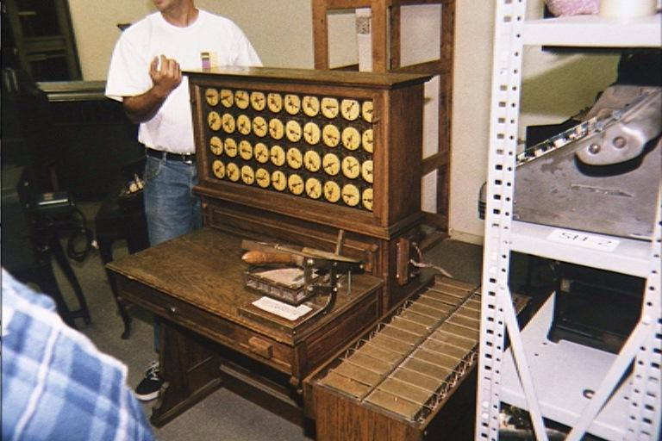
Hollerith desks still exist today

Slide 44
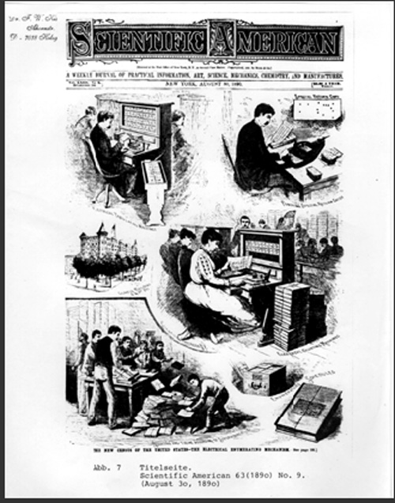
Hollerith and IBM
Incidentally, the Hollerith census machine was the first machine to ever be featured on a magazine cover.
Hollerith built a company, the Tabulating Machine Company which, after a few buyouts, eventually became International Business Machines, known today as IBM. IBM grew rapidly and punched cards became ubiquitous.

Slide 45
More about IBM
IBM continued to develop mechanical calculators for sale to businesses to help with financial accounting and inventory accounting.
One early success was the Harvard Mark I computer which was built as a partnership between Harvard and IBM

Slide 46
First Generation - 1940-1956
Major Innovation – Vacuum Tube
The first computers used vacuum tubes and were often enormous, taking up entire rooms.
They were very expensive to operate and in addition to using a great deal of electricity, generated a lot of heat, which was often the cause of malfunctions.
The UNIVAC and ENIAC computers are examples of first-generation computing devices.

Slide 47
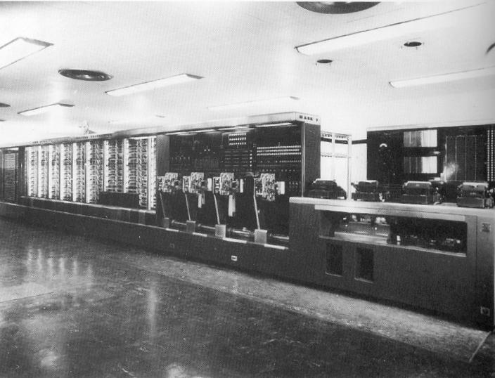
Mark 1

Slide 48
Mark 1
This was the first programmable digital computer made in the U.S.
It was not a purely electronic computer. Instead the Mark I was constructed out of switches, relays, rotating shafts, and clutches.
The machine weighed 5 tons, incorporated 500 miles of wire, was 8 feet tall and 51 feet long, and had a 50 ft rotating shaft running its length, turned by a 5 horsepower electric motor.
The Mark I ran non-stop for 15 years, sounding like a roomful of ladies knitting.

Slide 49
History of ‘Bug’
One of the primary programmers for the Mark I was a woman, Grace Hopper.
Hopper found the first computer "bug": a dead moth that had gotten into the Mark I and whose wings were blocking the reading of the holes in the paper tape.
The word "bug" had been used to describe a defect since at least 1889 but Hopper is credited with coining the word "debugging" to describe the work to eliminate program faults.

Slide 50
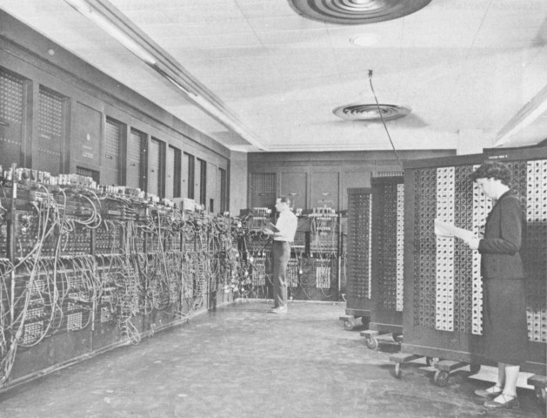
Year : 1943 – 1945
The first electronic digital computer ENIAC (Electronic Numerical Integrator and Calculator)
ENIAC was built by two professors, John Mauchly and J. Presper Eckert at the University of Pennsylvania

Slide 51
Second Generation - 1956-1963:
Major Innovation – Transistor
The transistor was far superior to the vacuum tube, allowing computers to become smaller, faster, cheaper, more energy-efficient and more reliable than their first-generation predecessors.
Though the transistor still generated a great deal of heat that subjected the computer to damage, it was a vast improvement over the vacuum tube. Second-generation computers still relied on punched cards for input and printouts for output.
The first computers of this generation were developed for the atomic energy industry.

Slide 52
Third Generation - 1964-1971
Major Innovation – Integrated Circuits / IC
The development of the Integrated Circuits was the hallmark of the third generation of computers.
Transistors were miniaturized and placed on semi conductor chips, called IC, which drastically increased the speed and efficiency of computers.
Instead of punched cards and printouts, users interacted with third generation computers through keyboards and monitors and interfaced with an operating system
Computers for the first time became accessible to a mass audience because they were smaller and cheaper than their predecessors

Slide 53
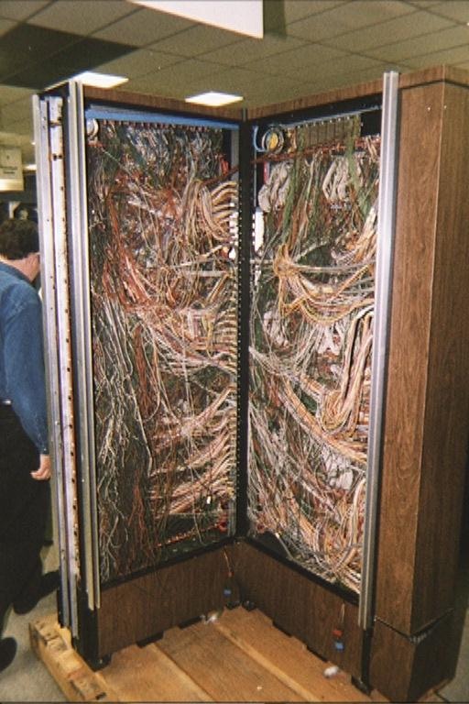
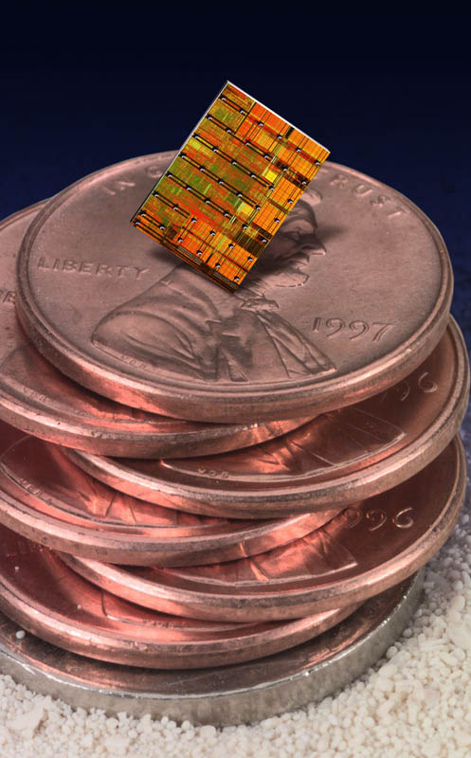
Revolution of IC

Slide 54
Fourth Generation - 1971-Present
Major Innovation – Microprocessor
Microprocessor is defined as thousands of integrated circuits were built onto a single silicon chip.
In 1981 IBM introduced its first computer for the home user
In 1984 Apple introduced the Macintosh.
As these small computers became more powerful, they could be linked together to form networks, which eventually led to the development of the Internet.

Slide 55
Fifth Generation - Present and Beyond
Major Innovation – Artificial Intelligence
Computers with intelligence like a human being
  Robotics
  Speech and Voice Recognition
  Image and Thumb recognition
  Simulation
  Virtual Reality
  Expert Systems
  Etc.

Slide 56
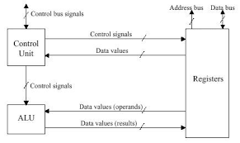
The Microprocessor
A combination of integrated circuit that contains all the functions of a central processing unit of a computer.

Slide 57
Parts of Microprocessor
Control Unit
  A control unit or CU is circuitry that directs operations within a computer's processor. It lets the computer's logic unit, memory, as well as both input and output devices know how to respond to instructions received from a program.
Arithmetic & Logical Unit
  An arithmetic logic unit (ALU) is a digital circuit used to perform arithmetic and logic operations. It represents the fundamental building block of the central processing unit (CPU) of a computer.
Memory Unit / Registers

Slide 58
Registers
A processor register (CPU register) is one of a small set of data holding places that are part of the computer processor.
A Program Counter / Instruction register hold an instruction
An Address register holds memory addresses
An Accumulator / Data register hold results of frequent calculations within microprocessor

Slide 59
Memory
Computer memory is any physical device capable of storing information by computer
Volatile memory is computer memory that requires power to maintain the stored information. (e.g. RAM, Cache, Register)
Non-volatile memory is computer memory that can retain the stored information even when not powered. (e.g. ROM, CMOS)

Slide 60
RAM
Random-access memory is the most common type of memory that stores data and applications currently being used or in execution by computer system. Most modern semiconductor volatile memory is either Static RAM or Dynamic RAM.
DRAM, or Dynamic RAM, is the most widely used RAM that consumers deal with. DDR3 is an example of DRAM. It needs to be refreshed periodically when in use,
SRAM does not need to be refreshed by microprocessor.

Slide 61
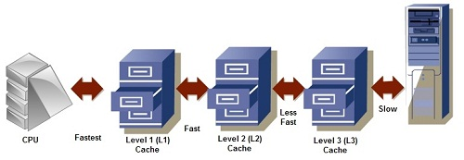
Cache Memory
The cache memory lies in the path between the processor and the memory. So, it is very near to the CPU and also called CPU memory, all the Recent Instructions are Stored into the Cache Memory.

Slide 62
Cache Memory Types
L1 cache, or primary cache, is extremely fast but relatively small, and is usually embedded in the processor chip as CPU cache.
L2 cache, or secondary cache, is larger than L1. L2 cache may be embedded on the CPU, or it can be on a separate chip.
Level 3 (L3) cache is specialized memory developed to improve the performance of L1 and L2. Also called as external cache.

Slide 63
ROM and Types
ROM stands for Read Only Memory. The memory from which we can only read but cannot write on it. This type of memory is non-volatile. The information is stored permanently in such memories during manufacture. A ROM stores such instructions that are required to start a computer.
PROM (programmable ROM) is a one - time user-programmable memory.
EPROM (erasable programmable ROM) was invented to allow making changes in the contents of PROM after it is burned.

Slide 64
ROM and Types
EEPROM (Electrically erasable PROM) does not require the entire contents of ROM are erased. However, the main advantage of EEPROM is that one can program and erase its contents while it is still in the system board. it does not require physical removal of the memory chip from its socket. In other words, unlike UV-EPROM, EEPROM does not require an external erasure and programming device.
4. Flash memory is used to store flexible boot instructions. It allows erasure of the entire contents takes less than a second, or one might say in a flash, hence its name, Flash memory.

Slide 65
CMOS
CMOS is short for complementary metal-oxide semiconductor.
CMOS is an on-board, battery powered semiconductor chip inside computers.
CMOS generally stores date/time or BIOS passwords information.

Slide 66
Computer Bus
A bus is a subsystem that is used to connect computer components and transfer data between them.
A System Bus connects microprocessor with RAM while, the control bus a set of connections among the parts in the computer.
The data bus acts as a channel for data from the keyboard, memory and other devices. It passes information at speeds up to billions of characters per second.
The computer must be able to access every character of memory rapidly, so every character has its own address number. The address bus carries such memory addresses.

